Slide 1
Salesforce API Access Manager, Monitor & Logger
Built using AWS and Salesforce, video voiced by AWS Polly

Slide 2
Use Case
While integrating API’s with common CRM systems like Salesforce/ZOHO/CRM Dynamics provide tiered access to system functionalities to external vendors.
Common approach is to build an API which used a principal credential to login and the access to all vendors is defined by that user.
The second approach is to have a per user authentication where each vendor has his own user and security can be controlled by profiles and permissions. This adds to recurring license cost for the organization and provides no single view to monitor the access.
Also, the logging for these has to be built in destination system.

Slide 3
Developed Solution
The solution we have developed lets you provide access management, monitors the logs and lets you publish the logs to CRM system or SQS queue or to a Dynamo DB or all of them at once.
Benefits
Tiered access provisioning using customer keys but a single user license.
Single place to view all access configuration,
Control over what can be accessed.
Log resource which are accessed.
To Salesforce
To Dynamo DB
To Simple Queue Service (SQS)

Slide 4




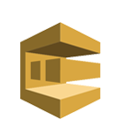
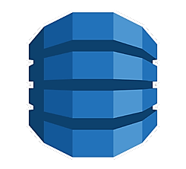
Gold User: Has access to all API features
CustomerKey: GU-123XXX
Accesses Dynamo DB Table to see which access is configured for the Customer Key
Normal User: Has access to cases
CustomerKey: NU-123XXX
LOGS
Blue User: Has access opportunity and cases.
CustomerKey: BU-123XXX
Access Check
LOGS
Orange User: Has access to accounts. CustomerKey: OU-123XXX
Salesforce_Access_Table
Stores access mapping
Salesforce_Log_Table
SQS Queue

Slide 5
DEMO

Slide 6

Thank you
Contact: manjit.aws@outlook.com

